Slide 1
Influence of US-China Trade War on main stocks from Basic Material, Energy, Health Care and Utility
UCLA Extension – Data Analysis and Visualization
Fengtian Zhang
2019-6-2

Slide 2
Introduction
Since US implements the first China-specific tariffs increase on July 6th, 2018, the trade war is on.
Investors start to realize that stock market is sensitive to the trade war signal and try to pull the money out of tech giants to some “safer” stocks which could be more predictable than trade war.
The purpose of this article is to find out which one of the four industries (Basic Material, Energy, Health Care and Utility) shows a weak influence by trade war. And furthermore, which company in that industry is least affected by trade war.

Slide 3
Overall Data Analysis Flow
Xls and csv
Python
Tableau
Data Collection
Trade War Time Line
Data Analysis and storage
Find Reference Data
Data Visualization
Connect to SQLite
DJI 5-Y historical data
4 Industries Top 10 Stock 5-Y historical data
Calculate Average Change Percentage per industry
Calculate Pearson Correlation Coefficient per industry
Calculate Pearson Correlation Coefficient in the least affected industry
Store data in SQLite
Import data for visualization
SQLite

Slide 4
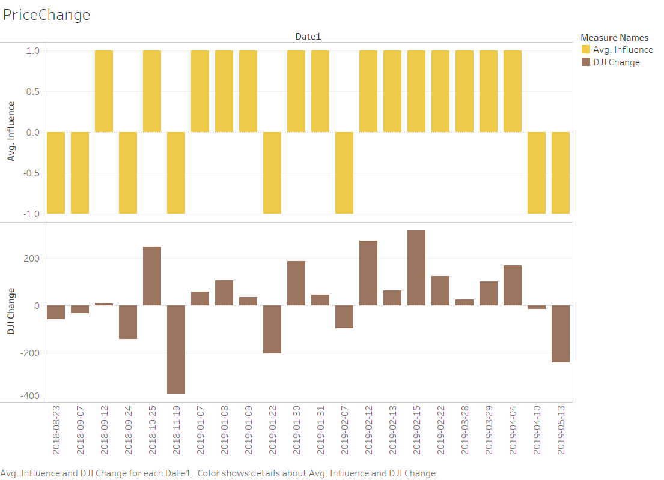
Positive-Negative Coefficient vs DJI price change

Slide 5
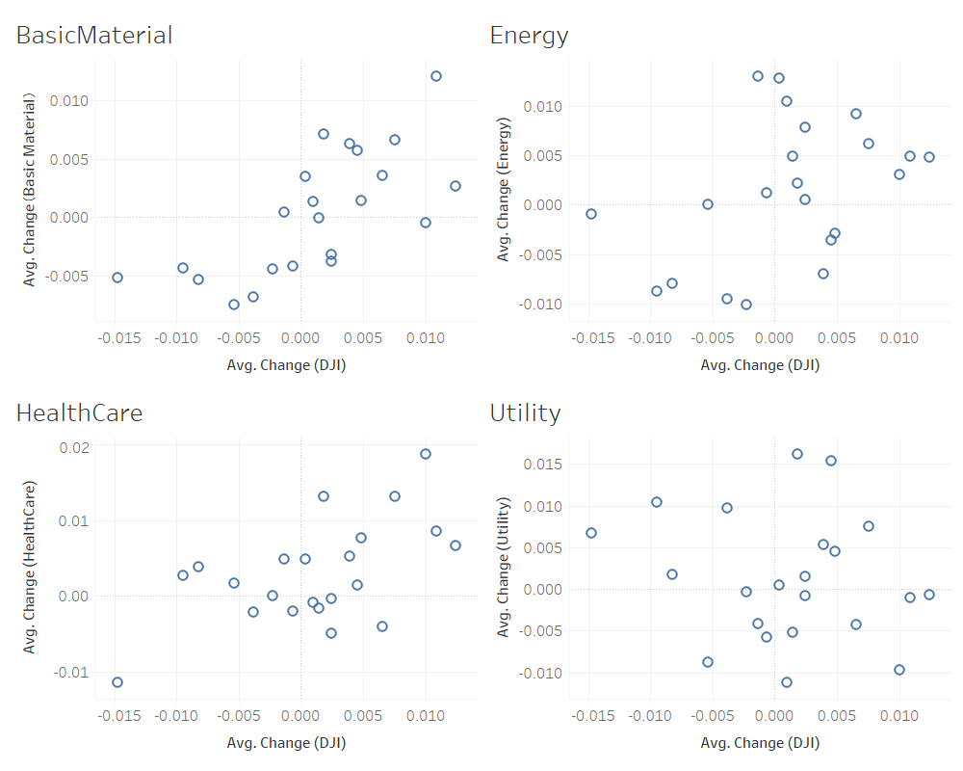
Change percentage per Industry vs DJI change percentage

Slide 6
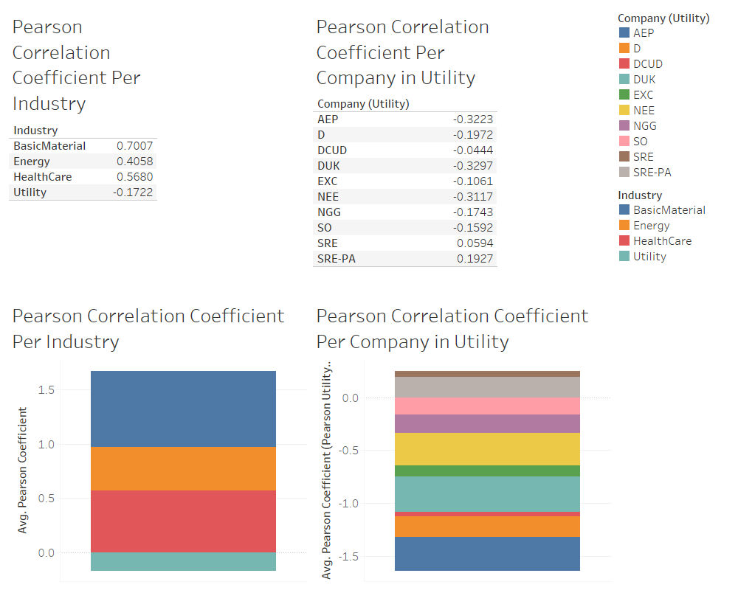
Pearson Correlation Coefficient per industry vs DJI and Pearson Correlation Coefficient between top 10 companies and DJI

Slide 7
Conclusion
Utility is less affected by US-China Trade war, and in its top 10 company, Dominion Energy, Inc. UT SER A 081519 (DCUD) is least affected based on the data collected
The work could be improved by the following:
Revise the reference data. In this article, only DJI is used. There are other data could be used as reference, like NASDAQ and S&P 500.
Research and find out the relationship between the China-US tariff list & entity list and the US companies. It could be quantized by using the dollar spent previously on the imports related to those lists per industry before and after tariff.
Find out the industries that has least China import before the tariff, and investigate the relationship between DJI and their stock price change on the reference dates.
Also analyze the weekly price change and compare against the daily price change to rule out some other factors.

Slide 8
References
[1] https://www.china-briefing.com/news/the-us-china-trade-war-a-timeline/
[2] https://finance.yahoo.com/
[3] https://docs.scipy.org/doc/scipy/reference/generated/scipy.stats.pearsonr.html scipy.stats.pearsonr
[4] https://blog.csdn.net/zhouwenyuan1015/article/details/65938847 python learning - pearsonr(x,y) pearson correlation coefficient calculation
[5] https://www.zhihu.com/question/19734616 How to understand pearson correlation coefficient calculation
[6]https://www.reuters.com/article/us-usa-trade-china-timeline/timeline-key-dates-in-the-us-china-trade-war-idUSKCN1SE2OZ

